Slide 1

Fake
News Detection
Naveen - 001582394
Vignesh - 001220018
Jaeline - 001257108

Slide 2
Table of Contents
01
02
03
04
05
06
07
08
About the Project
Use Cases
Methodology
Data Source
Milestones
Code
Acceptance Criteria
Project Goals

Slide 3
Fake News
The idea is to learn the system!
What more to look for a pool large volume of data, than our social media! Everyday millions of tweets are posted by users around the world. The pandemic has just brought in even tweets posted everyday so people could stay connected, some which maybe even more misleading. Here we try to solve this with machine learning model!

Slide 4
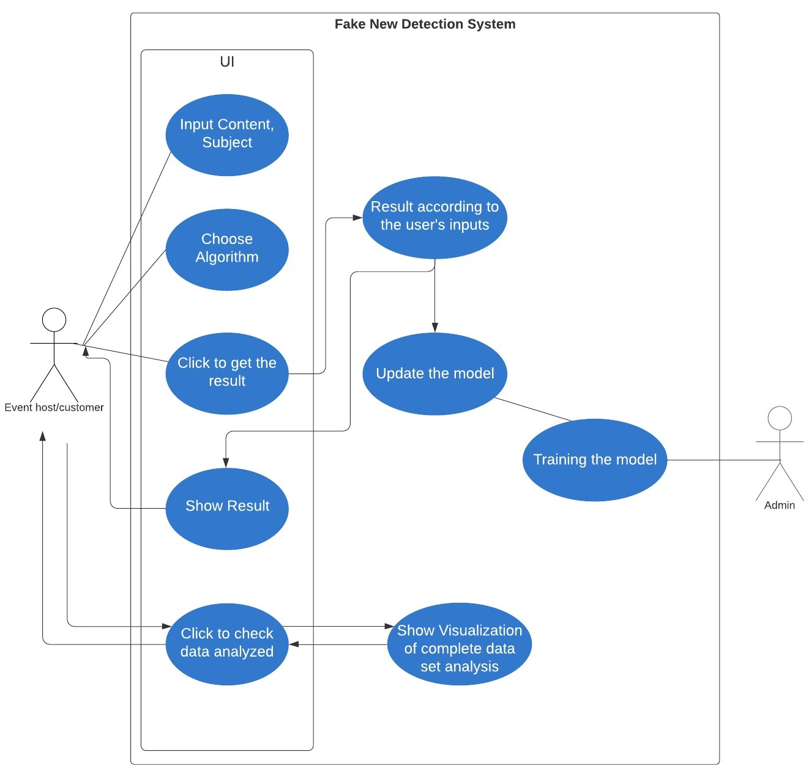
Use Case

Slide 5
Methodology (1/2)
Design UI using HTML, Javascript, API to Scala Backend
Update existing dataset using Spark Streaming to gather the data from Twitter API
TF- IDF to create dictionary on the tweets
Apply Random Forest/ Naive Bayes
Model Tuning to improve model performance

Slide 6
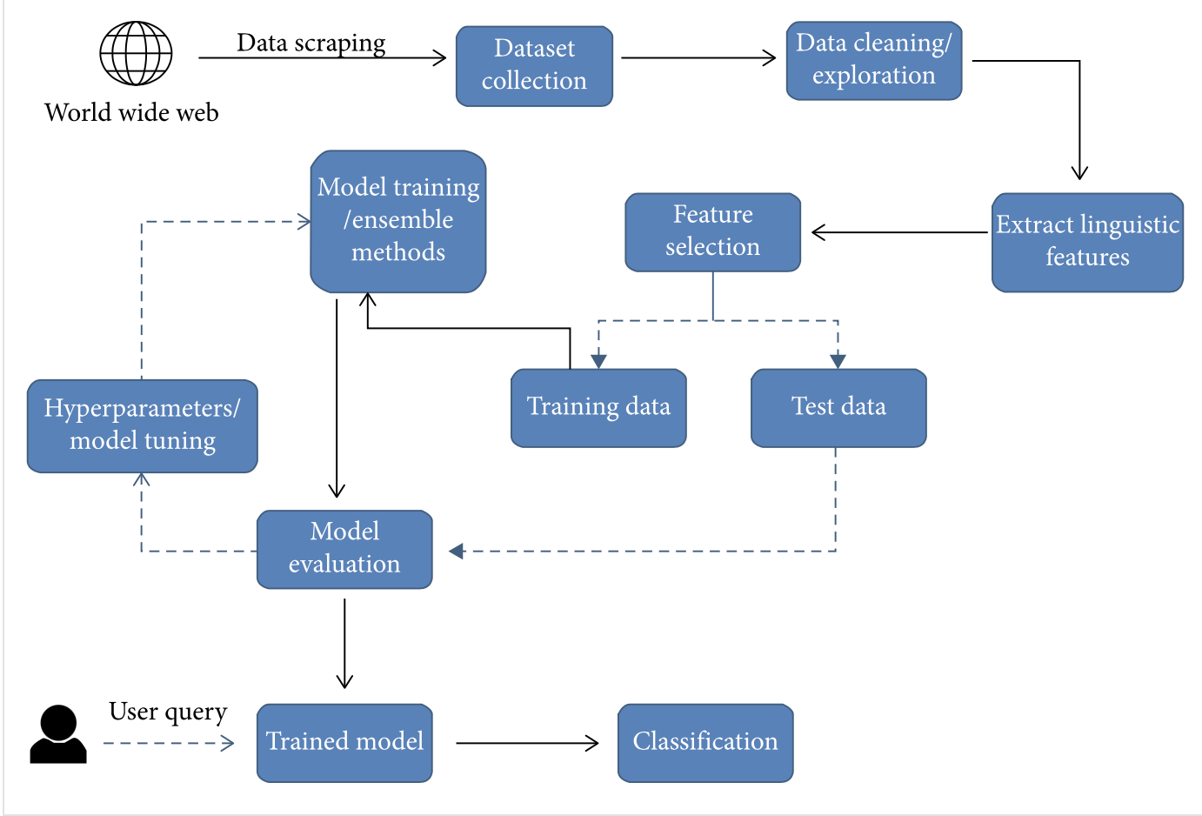
Methodology (2/2)

Slide 7
Data Source
Kaggle
Twitter
We source part of our data from
Kaggle measuring ~ 111MB & 18k unique values
https://www.kaggle.com/clmentbisaillon/fake-and-real-news-dataset
We use Twitter API to stream live data

Slide 8
Milestones/Sprints
- Implement machine learning model for news classification
- Ensure all units test pass
- Check system with use cases
04/01 - 04/05
04/11 - 04/16
04/18 - 04/21
01
02
03
04
05
04/05 - 04/11
04/16 - 04/18
- Build and design user interface
- Finalize presentation
- Conclusion of data analysis
- Create series of unit tests
- Load, clean and process dataset

Slide 9
Code
Website
Training
Building
A web page to get the user’s input
Build the ML models with MLlib
Improve the model performance
Git: https://github.com/maroovi/Fake-News-Detection-with-NLP.git

Slide 10
Acceptance Criteria
UI to accept Users input and visualize the data
Model Response < 5s
Model Accuracy
65%

Slide 11
Project Goals
GOAL 1
GOAL 2
GOAL 3
Use Spark Streaming and Spark MLib
An ML model to detect fake tweets
Visualize trends of Fake news

